Slide 1
AI RESUME ANALYZER

Slide 2
INDEX
Introduction Problem Statement & Objectives Existing vs Proposed System Technology Stack System Architecture Workflow Project Modules Algorithm Implementation Project Output :- Figure-1 (Home Page) Figure-2 (Resume Upload) Figure-3 (Result) Results Advantages & Limitations Future Scope Conclusion

Slide 3
AI RESUME ANALYZER
Submitted By Preeti Roll No 301311323089 Department Computer Science and Engineering (Artificial Intelligence) College Rungta College of Engineering & Technology, Bhilai Academic Session 2025–2026 Guide Mr. Kailash Kumar Patel

Slide 4
INTRODUCTION
AI Resume Analyzer is a web-based application developed to help job seekers evaluate their resumes efficiently. The system uses Python, Flask, HTML, CSS, and basic Natural Language Processing (NLP) techniques to compare a candidate's resume with a job description. It identifies matched and missing skills, calculates a resume-job match score, and provides useful feedback for improvement. This project simplifies the resume screening process, saves time for recruiters, and helps candidates optimize their resumes according to job requirements. It is user-friendly, easy to use, and demonstrates the practical application of artificial intelligence in the recruitment and hiring process. Developed using Python and Flask. Provides a simple and user-friendly interface. Accepts resumes in PDF format. Compares resumes with job descriptions. Identifies matched and missing skills. Calculates the resume-job match score. Demonstrates the use of AI and NLP in recruitment.

Slide 5
PROBLEM STATEMENT & OBJECTIVES
PROBLEM STATEMENT Manual screening Time consuming Human errors No automatic scoring OBJECTIVES Resume Upload Skill Detection Job Description Matching Match Score Generation

Slide 6
EXISTING VS PROPOSED SYSTEM
EXISTING SYSTEM Manual Resume Screening Slow Process Human Errors PROPOSED SYSTEM AI Resume Analyzer Automatic Skill Detection Resume Matching Match Score

Slide 7
TECHNOLOGY STACK
Python Flask HTML CSS PyPDF2 VS Code GitHub

Slide 8
SYSTEM ARCHITECTURE
User ↓ Upload Resume ↓ Text Extraction ↓ Skill Detection ↓ Job Description Matching ↓ Match Score ↓ Result

Slide 9
WORKFLOW
Upload Resume Extract Text Detect Skills Enter Job Description Compare Skills Generate Match Score Display Result

Slide 10
PROJECT MODULES
Resume Upload Module Text Extraction Module Skill Detection Module Job Description Module Result Module

Slide 11
ALGORITHM
Upload Resume Read PDF Extract Text Identify Skills Compare with Job Description Calculate Match Score Display Result

Slide 12
IMPLEMENTATION
BACKEND Python Flask FRONTEND HTML CSS LIBRARY PyPDF2 IDE VS Code

Slide 13
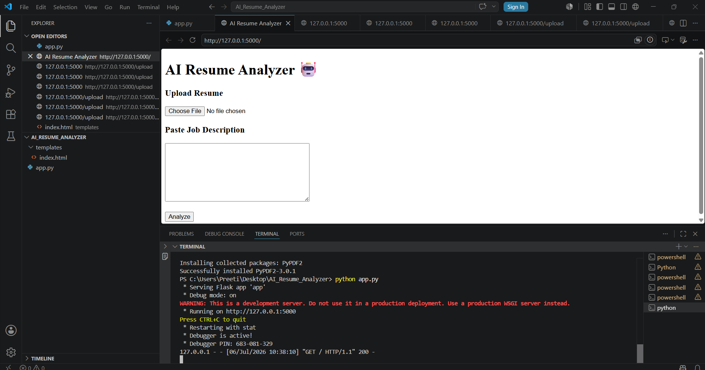
PROJECT OUTPUT
FIGURE-1 (HOME PAGE)

Slide 14
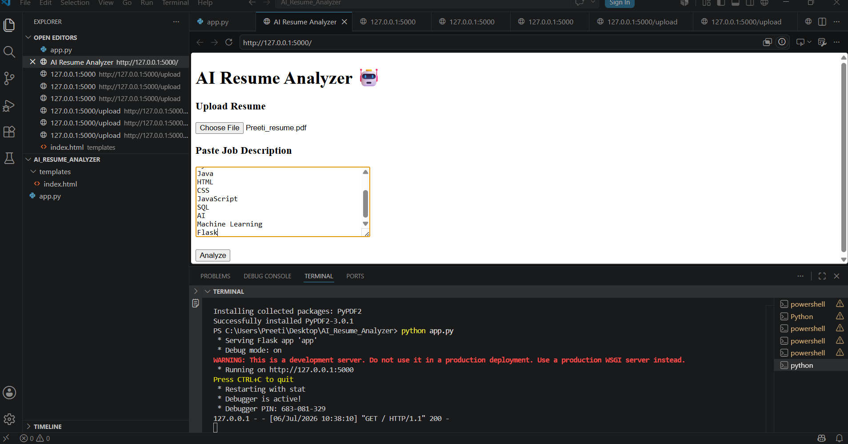
PROJECT OUTPUT
FIGURE-2 (RESUME UPLOAD)

Slide 15
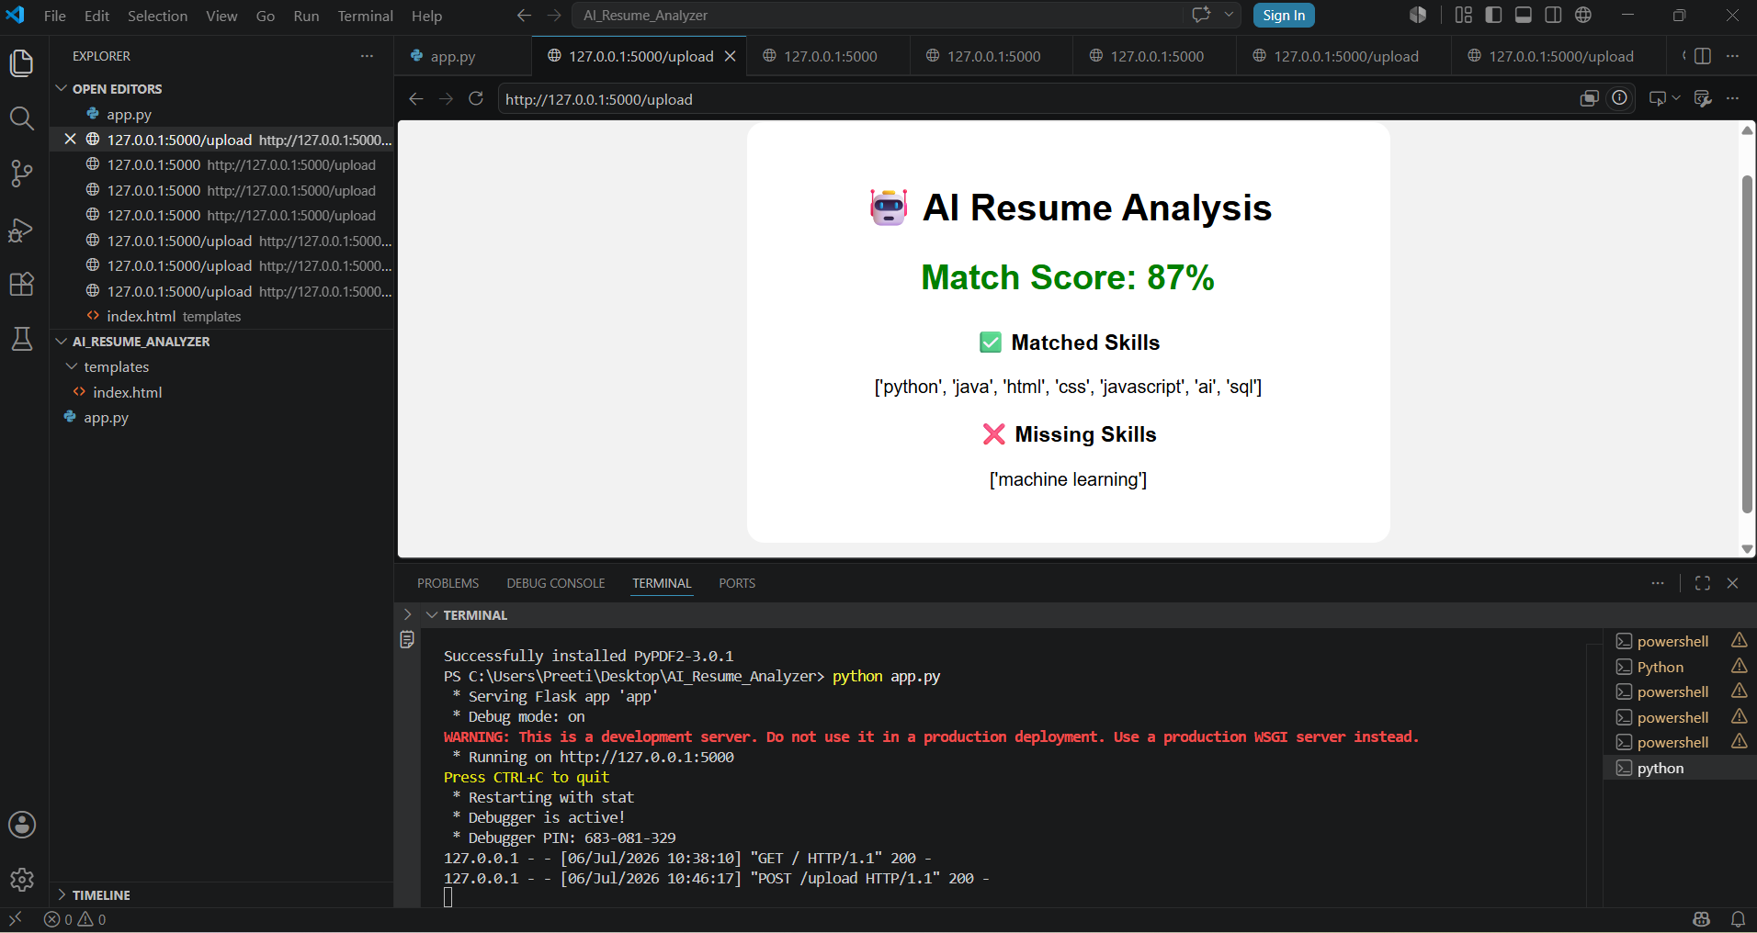
PROJECT OUTPUT
FIGURE-3 (RESULT)

Slide 16
RESULTS
Match Score - 87% Matched Skills Python HTML CSS JavaScript Machine Learning AI SQL Missing Skills also displayed successfully.

Slide 17
ADVANTAGES & LIMITATIONS
ADVANTAGES Fast User Friendly Automatic Analysis Saves Time AI Based LIMITATIONS PDF Only Keyword Matching Limited NLP

Slide 18
FUTURE SCOPE
NLP Integration Machine Learning ATS Score Cloud Deployment Database Support Resume Recommendation

Slide 19
CONCLUSION
The AI Resume Analyzer successfully automates the resume screening process by extracting text from PDF resumes, identifying technical skills, and comparing them with job descriptions. It generates a match score and highlights matched as well as missing skills, making the recruitment process faster and more efficient. The system reduces manual effort, saves time, and helps recruiters identify suitable candidates quickly. It also provides useful feedback to job seekers for improving their resumes. This project demonstrates the practical application of Artificial Intelligence in recruitment and can be further enhanced with Machine Learning, Natural Language Processing (NLP), and cloud-based deployment in the future.

Slide 20
THANK YOU

